Slide 1
Azure Networking

Slide 2
Azure Networking
Connect and deliver your hybrid and cloud-native applications with low-latency, Zero Trust based networking services
Virtual Networks
Network Security Groups
Azure Firewall
Azure DNS
Virtual Network Peering
VPN Gateway
Express Route
Virtual WAN
Azure Load Balancer and Application Gateway

Slide 3
Azure Virtual Networks
Build and manage a secure network infrastructure in the cloud
Create sophisticated network topologies using virtual appliances
Bring your own IP addresses and DNS servers.
Get granular control over traffic between subnets
Get an isolated and highly secure environment for your applications.
A VNet is a representation of your own network in the cloud

Slide 4
Capabilities of Virtual Networks
Azure VNets enable resources in Azure to securely communicate with each other, the internet, and on-premises networks
Communication with the internet
Communication between Azure resources
Communication between on-premises resources
Filtering network traffic
Routing network traffic

Slide 5
Design considerations for Azure Virtual Networks
Address Space and Subnets
We can create multiple networks per region and per subscription.
We can create multiple subnets with in each virtual networks
Virtual Network
When creating a VNet, it is recommended that you use the address ranges enumerated in RFC 1918, which have been set aside by the IETF for private, non-routable address spaces:
10.0.0.0 - 10.255.255.255 (10/8 prefix)
172.16.0.0 - 172.31.255.255 (172.16/12 prefix)
192.168.0.0 - 192.168.255.255 (192.168/16 prefix)

Slide 6
Azure Vnet Address Space Reservation
Azure assigns resources in a virtual network a private IP address from the address space that you provision. For example, if you deploy a VM in a VNet with subnet address space 192.168.1.0/24, the VM will be assigned a private IP like 192.168.1.4. Azure reserves the first four and last IP address for a total of 5 IP addresses within each subnet. These are x.x.x.0-x.x.x.3 and the last address of the subnet.
For example, the IP address range of 192.168.1.0/24 has the following reserved addresses:
192.168.1.0 : Network address
192.168.1.1 : Reserved by Azure for the default gateway
192.168.1.2, 192.168.1.3 : Reserved by Azure to map the Azure DNS IPs to the VNet space
192.168.1.255 : Network broadcast address.

Slide 7
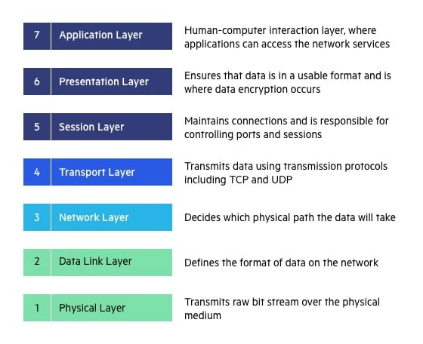
OSI Reference Model
Stands for “Open Systems Interconnection” and developed by ISO-“International Organization for Standardization” in the year of 1984
OSI Model is a 7 layer architecture with each layer having specific functionality to perform
All these layers work collectively to transmit the data from one person to another across the globe

Slide 8
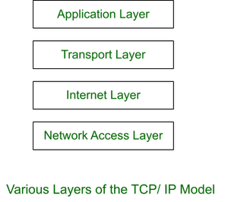
TCP/IP Model
TCP/IP model, it was designed and developed by Department of Defense (DoD) in 1960s and is based on standard protocols.
It stands for Transmission Control Protocol/Internet Protocol
The TCP/IP model is a concise version of the OSI model. It contains four layers, unlike seven layers in the OSI model

Slide 9
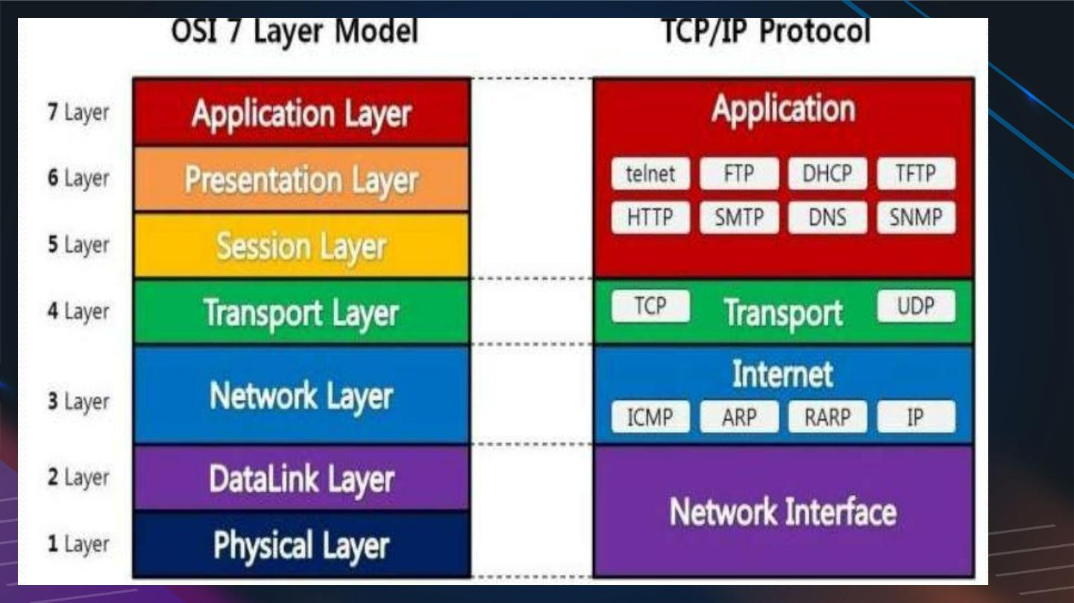
OSI vs TCP/IP

Slide 10
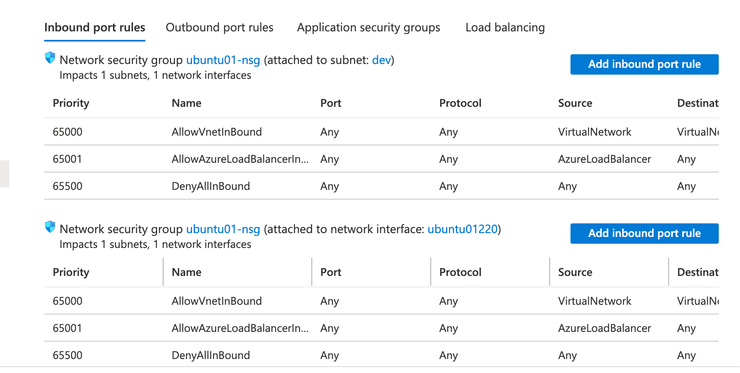
Network Security Group(NSG)
Azure network security group to filter network traffic between Azure resources in an Azure virtual network
A network security group contains security rules that allow or deny inbound network traffic to, or outbound network traffic from, several types of Azure resources
For each rule, you can specify source and destination, port, and protocol
A network security group contains zero, or as many rules as desired, within Azure subscription limits

Slide 11
Security Group Rule Properties
Property | Explanation
Name | A unique name within the network security group
Priority | A number between 100 and 4096. Rules are processed in priority order, with lower numbers processed before higher numbers, because lower numbers have higher priority Once traffic matches a rule, processing stops. As a result, any rules that exist with lower priorities (higher numbers) that have the same attributes as rules with higher priorities aren't processed
Source/destination | Any, or an individual IP address, classless inter-domain routing (CIDR) block (10.0.0.0/24, for example), service tag, or application security group
Protocol | Any, TCP, UDP, ICMP
Direction | Whether the rule applies to inbound, or outbound traffic
Ports range | 0-65535
Action | Allow or Deny

Slide 12
Azure Firewall
Azure Firewall is a managed, cloud-based network security service that protects your Azure Virtual Network resources.
You can centrally create, enforce, and log application and network connectivity policies across subscriptions and virtual networks.
Azure NSG vs Azure Firewall
NSG | Firewall
Network security groups provide distributed network layer traffic filtering to limit traffic to resources within virtual networks in each subscription | The Azure Firewall service complements network security group functionality Azure Firewall is a fully stateful, centralized network firewall as-a-service, which provides network- and application-level protection across different subscriptions and virtual networks.

Slide 13
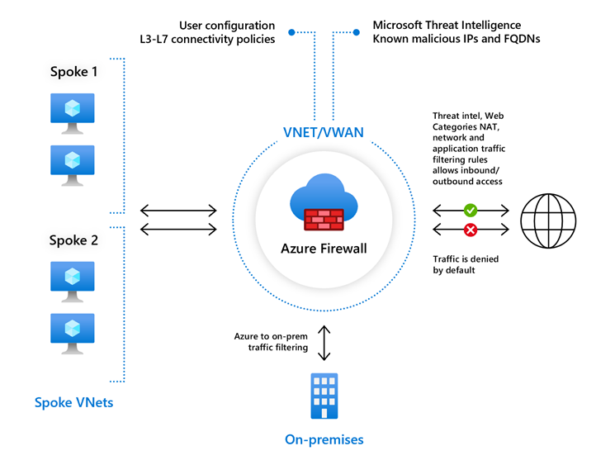
Azure Firewall

Slide 14
VNet Design
Consider availability zones when designing your Azure network, and plan for services that support availability zones.
Azure services that support Availability Zones fall into three categories:
Zonal services: Resources can be pinned to a specific zone. For example, virtual machines, managed disks, or standard IP addresses can be pinned to a specific zone, which allows for increased resilience by having one or more instances of resources spread across zones.
Zone-redundant services: Resources are replicated or distributed across zones automatically. Azure replicates the data across three zones so that a zone failure does not impact its availability.
Non-regional services: Services are always available from Azure geographies and are resilient to zone-wide outages as well as region-wide outages.

Slide 15
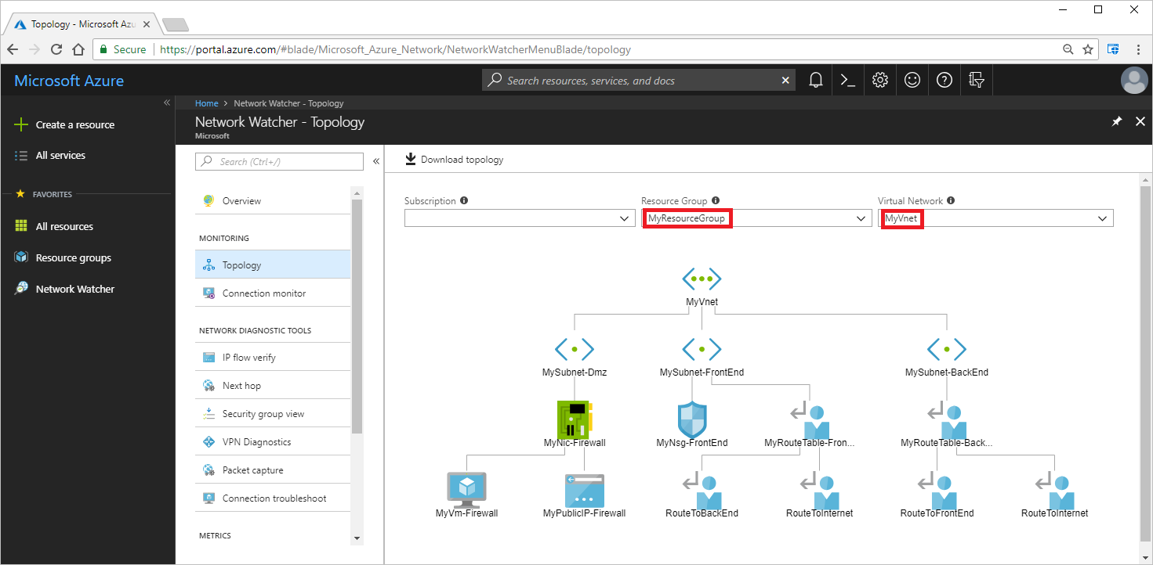

Slide 16
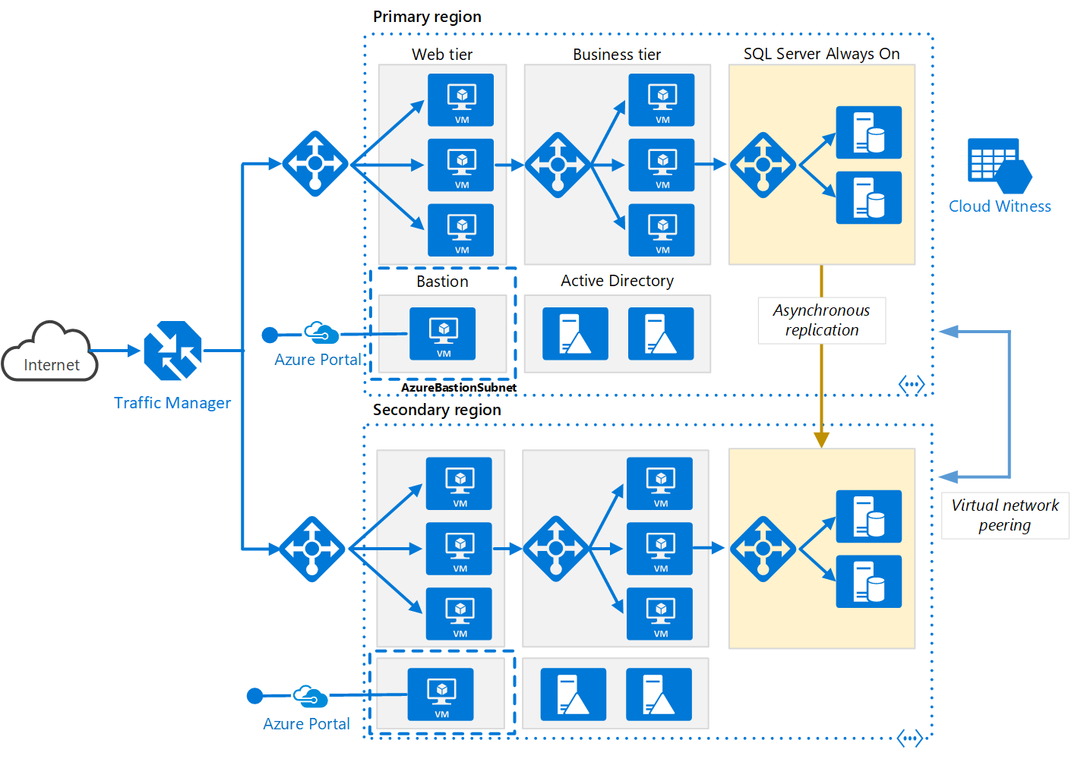

Slide 17
Public IP
Public IP addresses enable Internet resources to communicate with Azure resources and enable Azure resources to communicate outbound with Internet and public-facing Azure services
Some of the resources you can associate a public IP address resource with:
Virtual machine network interfaces
Virtual machine scale sets
Public Load Balancers
Virtual Network Gateways (VPN/ER)
NAT gateways
Application Gateways
Azure Firewall
Bastion Host
Route Server

Slide 18
Public IP’s types
A dynamic public IP address is an assigned address that can change over the lifespan of the Azure resource. The dynamic IP address is allocated when you create or start a VM. The IP address is released when you stop or delete the VM. In each Azure region, public IP addresses are assigned from a unique pool of addresses. The default allocation method is dynamic.
A static public IP address is an assigned address that will not change over the lifespan of the Azure resource. To ensure that the IP address for the resource remains the same, set the allocation method explicitly to static. In this case, an IP address is assigned immediately. It is released only when you delete the resource or change the IP allocation method to dynamic.

Slide 19
Azure DNS
Azure DNS is a hosting service for DNS domains that provides name resolution by using Microsoft Azure infrastructure.
By hosting your domains in Azure, you can manage your DNS records by using the same credentials, APIs, tools, and billing as your other Azure services
DNS Records
A record - The record that holds the IP address of a domain. Learn more about the A record.
AAAA record - The record that contains the IPv6 address for a domain (as opposed to A records, which list the IPv4 address).
CNAME record - Forwards one domain or subdomain to another domain, does NOT provide an IP address.
MX record - Directs mail to an email server.
TXT record - Lets an admin store text notes in the record. These records are often used for email security.
NS record - Stores the name server for a DNS entry.
SOA record - Stores admin information about a domain.
SRV record - Specifies a port for specific services.
PTR record - Provides a domain name in reverse-lookups.

Slide 20
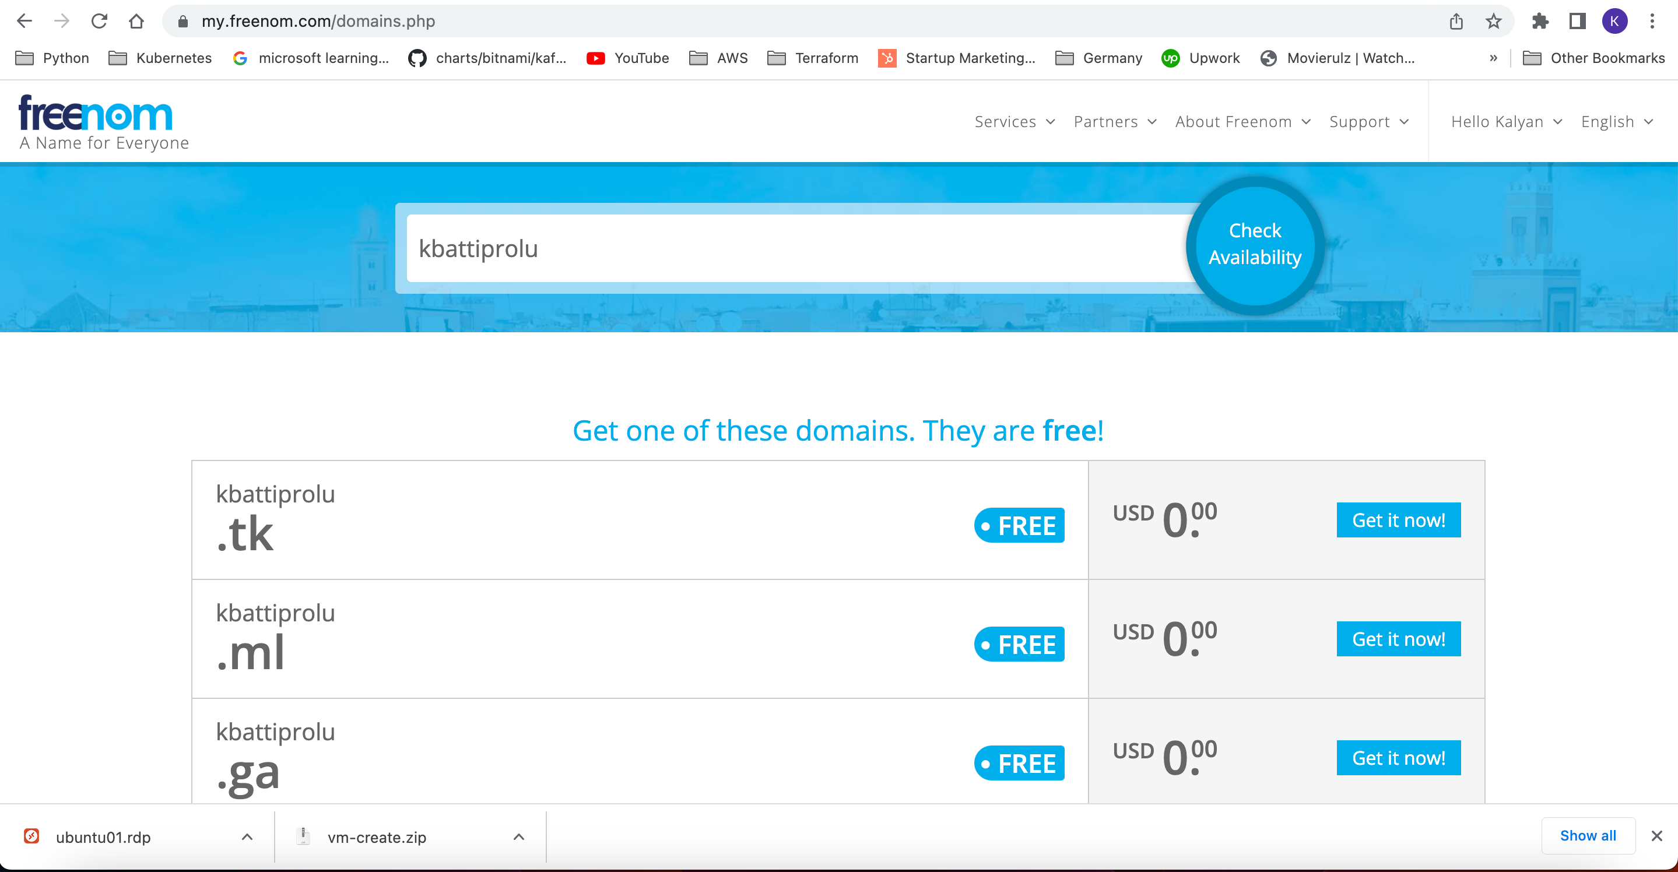
Free DNS Creation
Go to https://www.freenom.com/ to get free dns name

